Slide 1
TOF System Performance:
Calibrations &
Time Resolutions
Frank Geurts
Rice University

Slide 2
Outline
Time-of-Flight in STAR
  start & stop detectors in Run 9
Time-of-Flight Calibration
  upVPD
  barrel TOF
  preliminary Run-9 results (500GeV & 200GeV)
Calibration History & Requirements
  calibration cross-verification
Summary

Slide 3
TOF in Run 9
Based on Multi-gap Resistive Plate Chambers (MRPC)
various prototypes since Run 3.
timing electronics based on CERN’s HPTDC chip
Significant increase in scale:
Run 8: 5 trays (4%)
Run 9: 86 out of 120 trays (72%)
Run 10: 120 trays (100%)
Run 9 experience:
stable running, TOF participated in nearly all runs;
9 dead channels out of 16,512;
average noise rate per channel is less than 10 Hz.

Slide 4
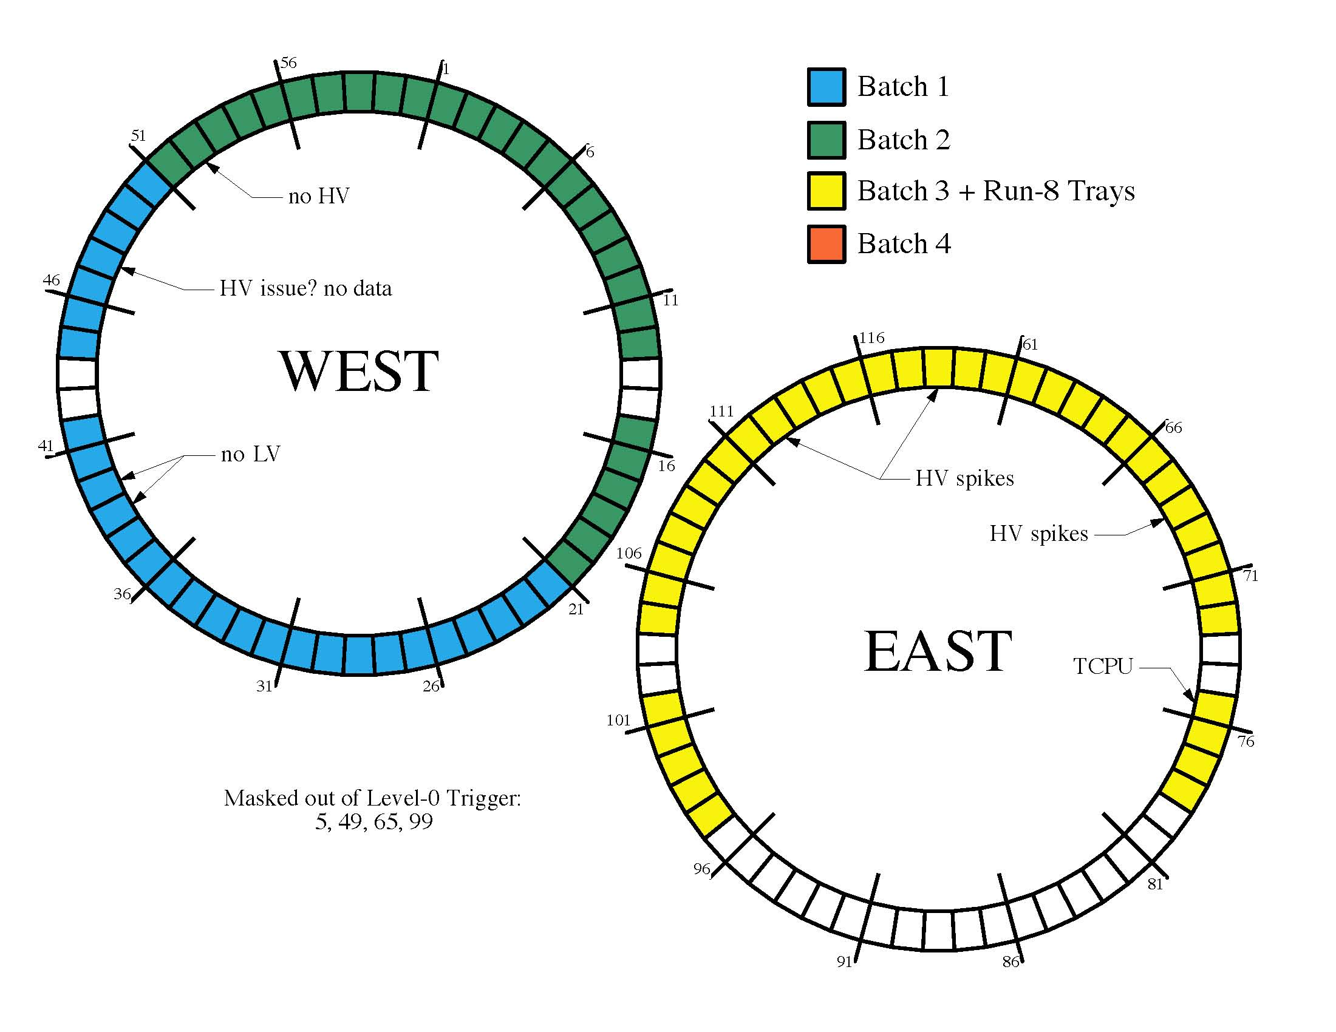
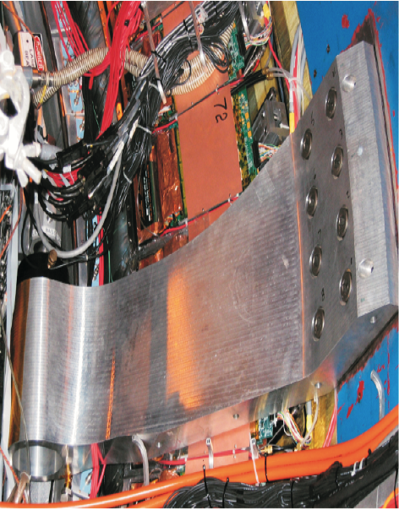
Run 9 TOF trays
WEST
EAST
TPC support arms
Run-8 trays

Slide 5
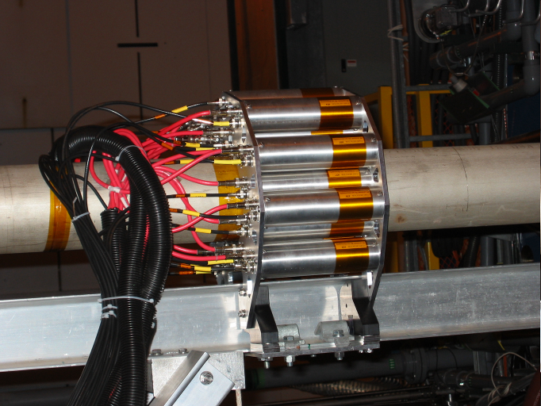
Start Side: the upVPD
upVPD replaced pVPD (Run 7):
  upgrade involves increase in # of channels from 6 to 38 channels (east + west)
  both based on scintillator and fast PMTs
  upVPD uses similar timing electronics as TOF
STAR |Z|=570cm and 4.24 < |η| < 5.1
collision point

Slide 6
TOF Calibrations
Integral Non-Linearity (INL)
Trigger timing window
Start-side calibration upVPD
  signal slewing, T vs. Time-over-Threshold (TOT)
Stop-side calibration Barrel TOF
  TOF T0
  signal slewing (T vs. TOT)
  MRPC cell signal propagation (T vs. Z_{local})
  tray alignment calibration

Slide 7
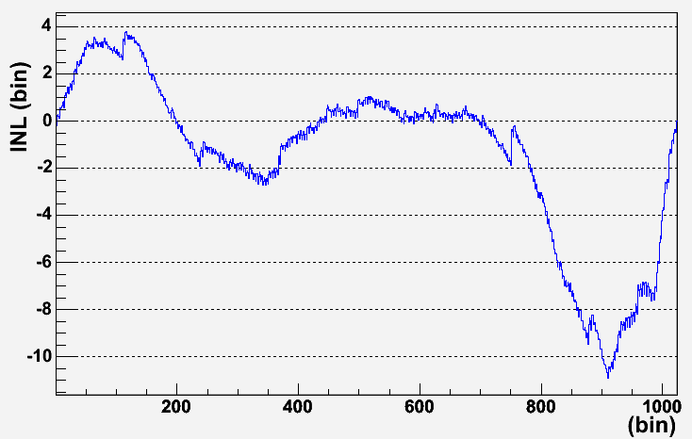
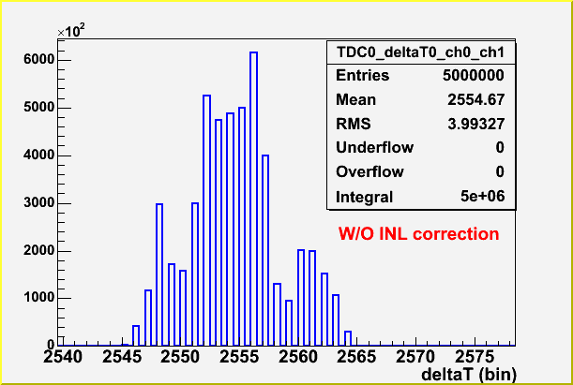
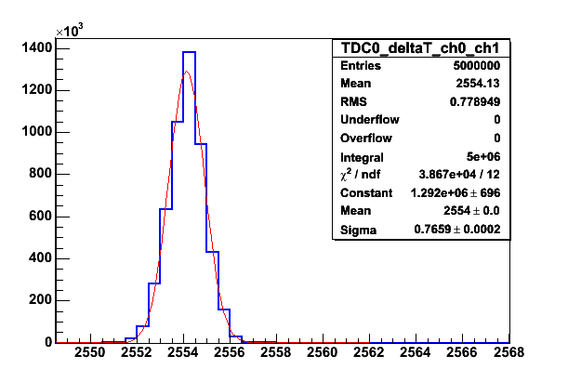
Integral Non-Linearity Calibration
Jing Liu
HPTDC integral non-linearity (INL):
periodicity 1024 bins (25ns)
calibration data collected on test bench
expect no change, but will monitor
RMS 3.993
INL correction determined for all TOF HPTDC channels
full TOF Barrel: 120x192 = 23k TDC channels
1024 bins/channel at 2byte precision
in STAR Offline Database
applied by offline software
RMS 0.7789
no INL applied
σ = 0.7659 ≈ 18ps
INL applied

Slide 8
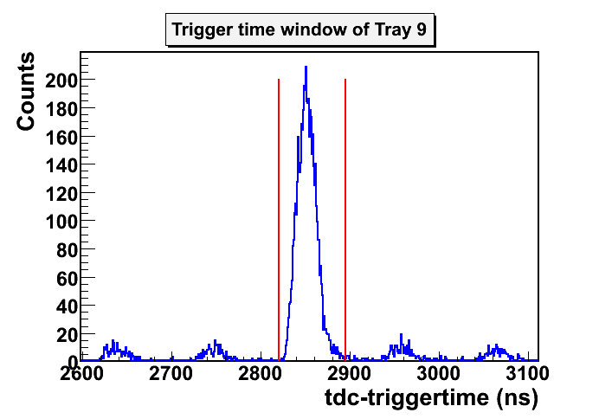
Trigger Matching Window
Xiaoping Zhang
Yi Zhou
HPTDC timing information is based on a free running clock
  determine optimal window for trigger timing
  timing affected by e.g. firmware changes
Final trigger timing window checked for Run 9 (500GeV and 200GeV)
based on Fast-Offline data
one parameter per tray,
ready for database
applied in offline software

Slide 9
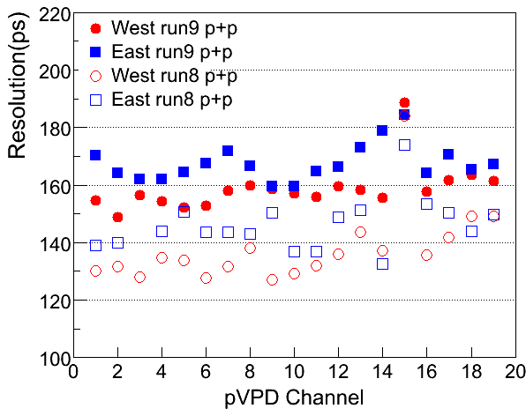
upVPD Calibration
Zebo Tang
Xiaoping Zhang
Preliminary Calibration of Run 9
  based on Fast-Offline production
  500GeV: ~3M events; 200GeV: ~6.8M events.
iterative process
separate East & West Calibration
low multiplicity in upVPD is an issue
  not all events will have a start-time
calibration constants ready for database (500GeV)
  200GeV in progress
applied in offfline production (StBTofCalibMaker)
500GeV

Slide 10
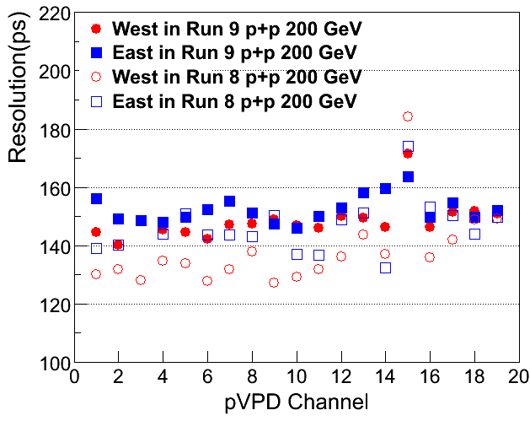
upVPD Calibration (cont’d)
200GeV p+p
Xiaoping Zhang
500GeV p+p
200GeV preliminary results based on recent calibration performed on subset of fast-offline data (days 132-152)
calibration procedure is sensitive to out-of-time “outlier” hits

Slide 11
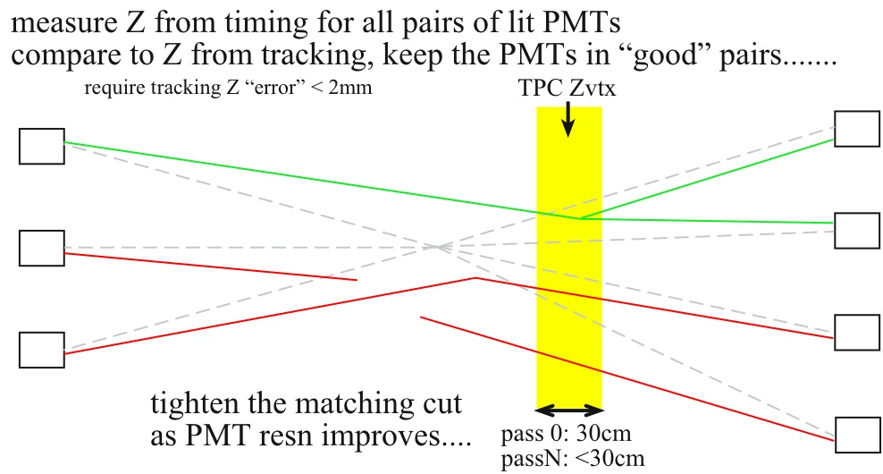
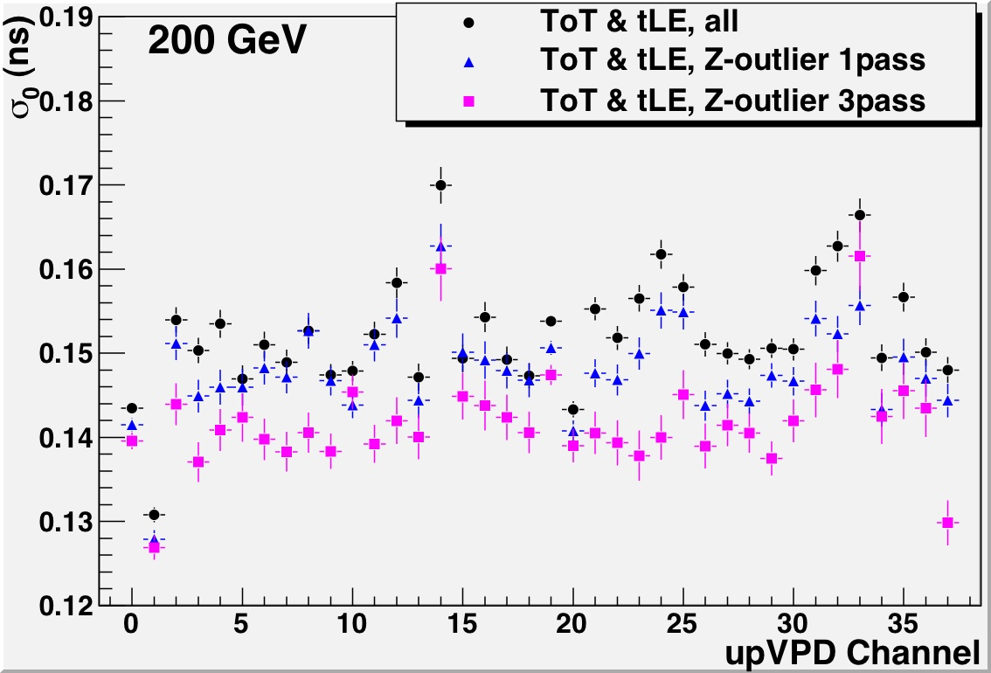
upVPD Calibration (cont’d)
Bill Llope
Alternative approach in upVPD calibration
less sensitive to “outliers”, e.g. potentially resulting from additional vertices.
Promising first results:
Resolution per upVPD channel ~140ps ➔ TOF start resolution < 100ps
(for 1.AND.1)
down to ~23ps (19.AND.19)

Slide 12
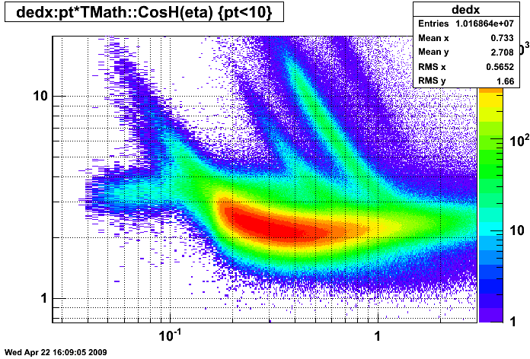
Barrel TOF Calibration
Zebo Tang
Use a clean π sample, either from TPC dE/dx (and momentum cuts) or a pre-calibrated TOF in the next iterations
T0 Calibration:
  compensate for differences in cable lengths and signal transition times.
  determined channel by channel, i.e. per MRPC cell
  parameters done for 500GeV
    Ready for database
    200GeV in progress
  applied in offline production (StBTofCalibMaker)
dE/dx (KeV/cm)
Momentum p (GeV/c)
Tray 119 – Module 1

Slide 13
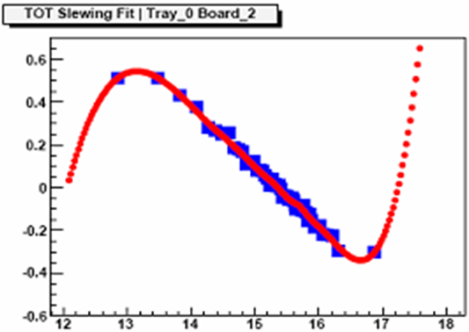
Barrel TOF Calibration (cont’d)
Slewing Correction
compensates for correlation between signal timing and signal height.
  time-over-threshold is proportional to signal height; based on a trailing edge timing measurement in addition to the leading edge
use spline fits, and store its shape, i.e. bin values
pp (500GeV): difficult to get enough statistics
  corrections were performed per TDIG board (4 MRPCs, 24 channels)
  Preliminary set ready for database, applied by StBTofCalibMaker
  200GeV data: first sample done, verification in progress
Run-8
[pp 200GeV]
Run-9 [500GeV]
3M events

Slide 14
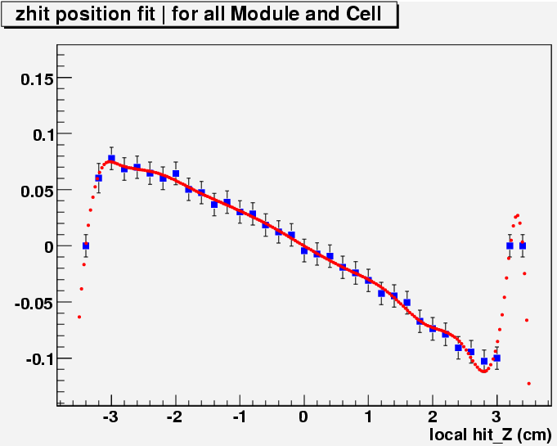
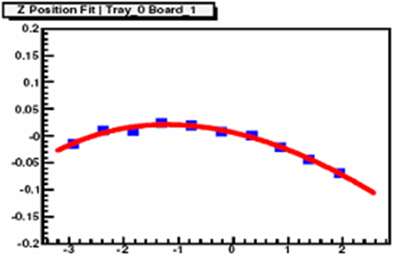
Barrel TOF Calibration (cont’d)
Local Z-hit position correction
  Expect a Z_{hit} dependence as signal propagation on the pick-up pads can be 40-50ps/cm
  No strong dependence observed in Run 8 and 9; not yet understood.
Corrections are available for Run 9 p+p
  500GeV: ready for database, applied by StBTofCalibMaker
  200GeV: verification in progress
Once a large statistical sample is available determine the tray alignment calibration
T-Z_{loc} correlation
in Run 5
Ming Shao
Run 8
Run 9

Slide 15
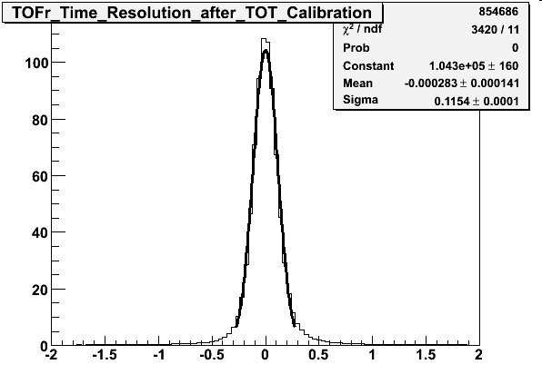
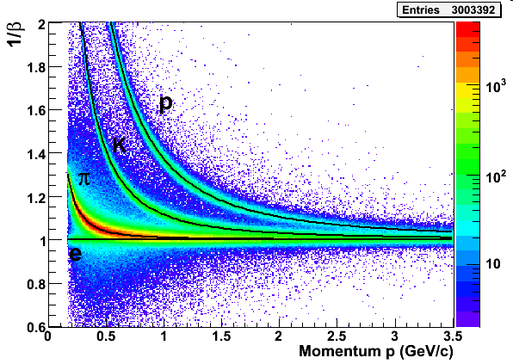
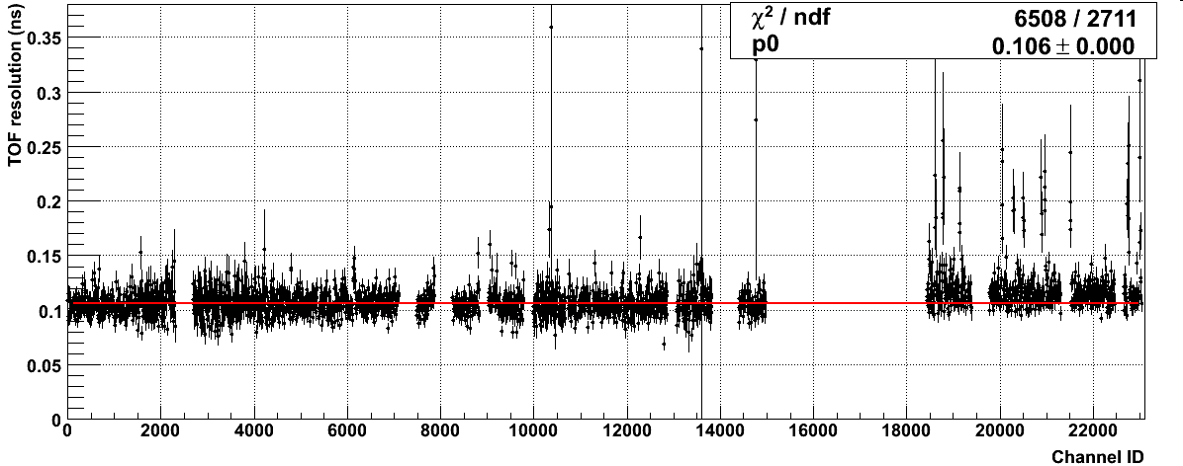
Preliminary Run 9 (500GeV) results
Zebo Tang
σ ≈115ps
ToT fit
failures

Slide 16
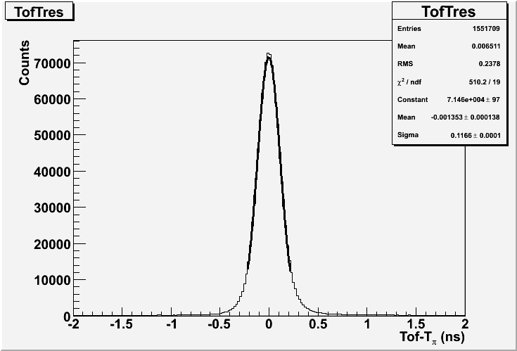
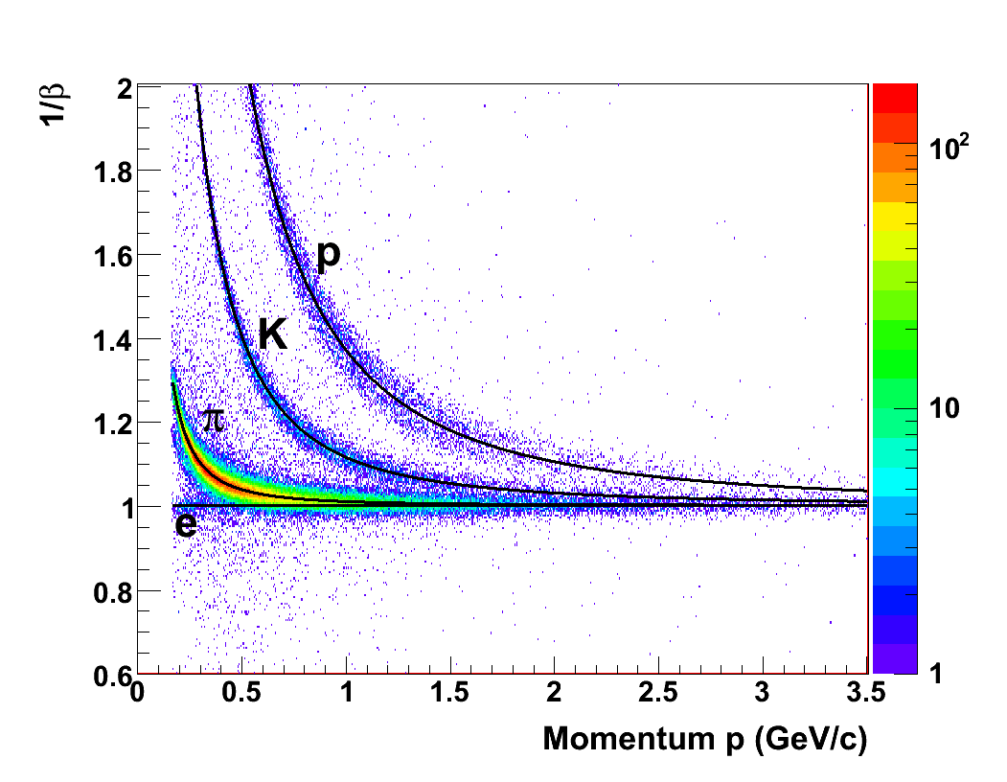
Preliminary Run 9 (200GeV) results
Xiaoping Zhang
σ ≈117ps
Preliminary 200GeV data based on subset of Fast-Offline data
  discriminator threshold similar to previous run periods
Near-future detailed studies on discriminator thresholds and magnetic field polarities
  significant 200GeV data sets available
Pending STAR production with final TPC calibrations (Sept.’09)

Slide 17
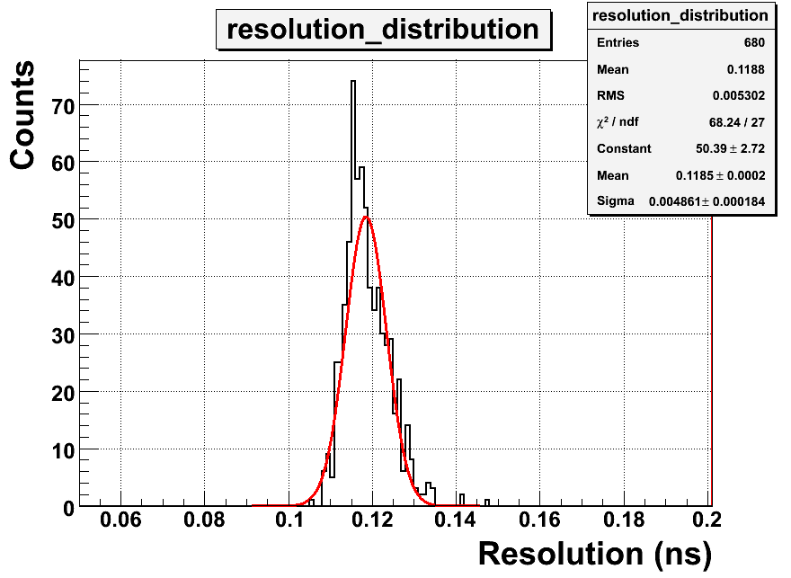
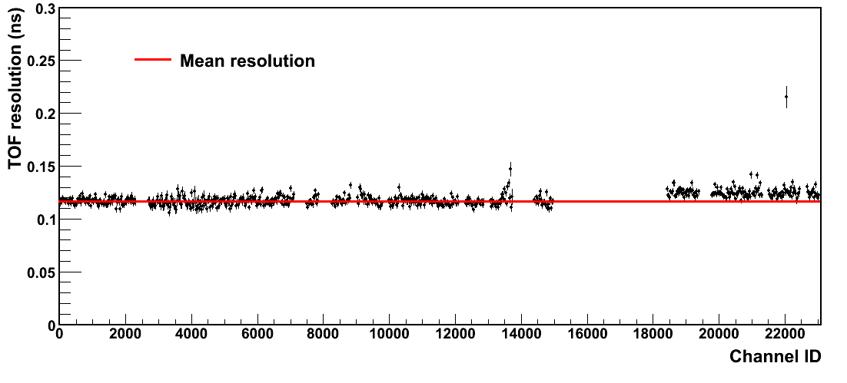
Preliminary Run 9 Results (cont’d)
time resolution distribution
  σ(σ_{TOF})= 5ns
Note: channels grouped by TDIG board
Xiaoping Zhang
time resolution per channel (board) for 200GeV p+p
failed T0 fit
failed ToT fit

Slide 18
History of Calibration Results
Operation condition |  |  | Time Resolution (ps)
 |  |  | Start time | Overall | Stop time
Run III | 200GeV d+Au |  | 85 | 120 | 85
 | 200GeV p+p |  | 140 | 160 | 80
Run IV | 62GeV Au+Au |  | 55 | 105 | 89
 | 200GeV Au+Au | FF/RFF | 27 | 86 | 82
 |  | HF | 20 | 82 | 80
Run V | 200GeV Cu+Cu (ToT) |  | 50 | 92 | 75
 | 62GeV Cu+Cu (ToT) |  | 82 | 125 | 94
Run VIII | 200GeV d+Au (ToT) |  | NA | NA | NA
 | 200GeV p+p (ToT) |  | 83 | 112 | 75
Run IX | 500GeV p+p (preliminary) |  | 85 | 115 | 78
 | 200GeV p+p (preliminary) |  | 90 | 117 | 74

Slide 19
Calibration Requirements
Collisions [MinBias] | taken from [1] | ×1/4 (pure π) ×80% (match) ×2 (Δη) | Useable hits per channel | Slewing Correction 10k/{ch,mod,brd} |  |  | T0 500/ch
 |  |  |  | channel-by- channel | mod-by-mod | board-by-board
p+p | 2.4 | 0.96 | 4.2e-5 | 240M | 40M | 10M | 12M
d+Au | 10.2 | 4.1 | 1.8e-4 | 56M | 9.3M | 2.3M | 2.8M
Au+Au | 200 | 80 | 3.5e-3 | 2.9M | 0.5M | 0.12M | 0.15M
Au+Au (0-10%) | 515 | 206 | 8.9e-3 | 1.2M | 0.2M | 0.05M | 0.06M
[1] STAR Collab. Phys.Rev.C79 034909 (2009)

Slide 20
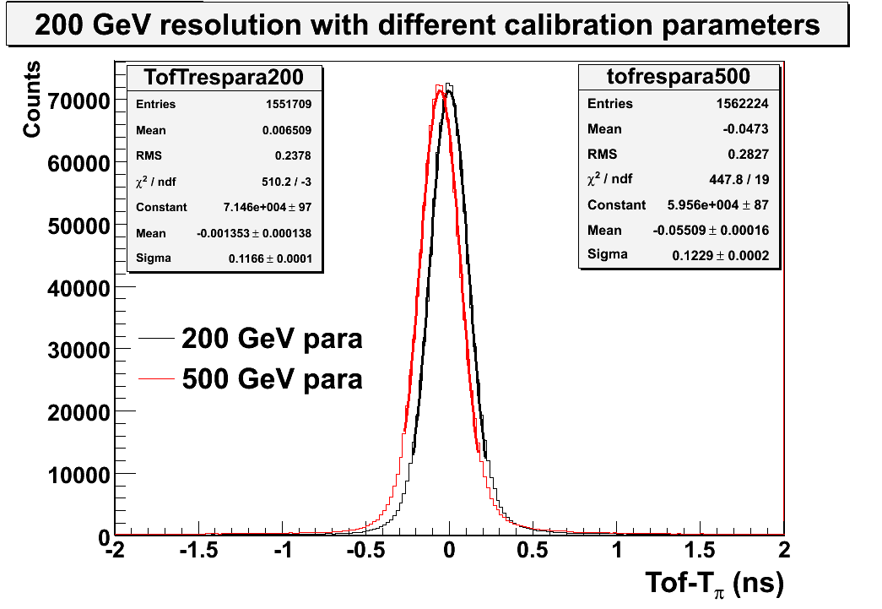
Cross-verification of Calibration
Significant statistics requirements effect turn-around time for prompt TOF PID
  application of “online” PID
Cross-verification of p+p calibration parameters
  apply 500GeV calibration on 200GeV data sample
σ ≈117ps
σ ≈123ps
Note that subtle differences remain, making these parameter sets not completely compatible.

Slide 21
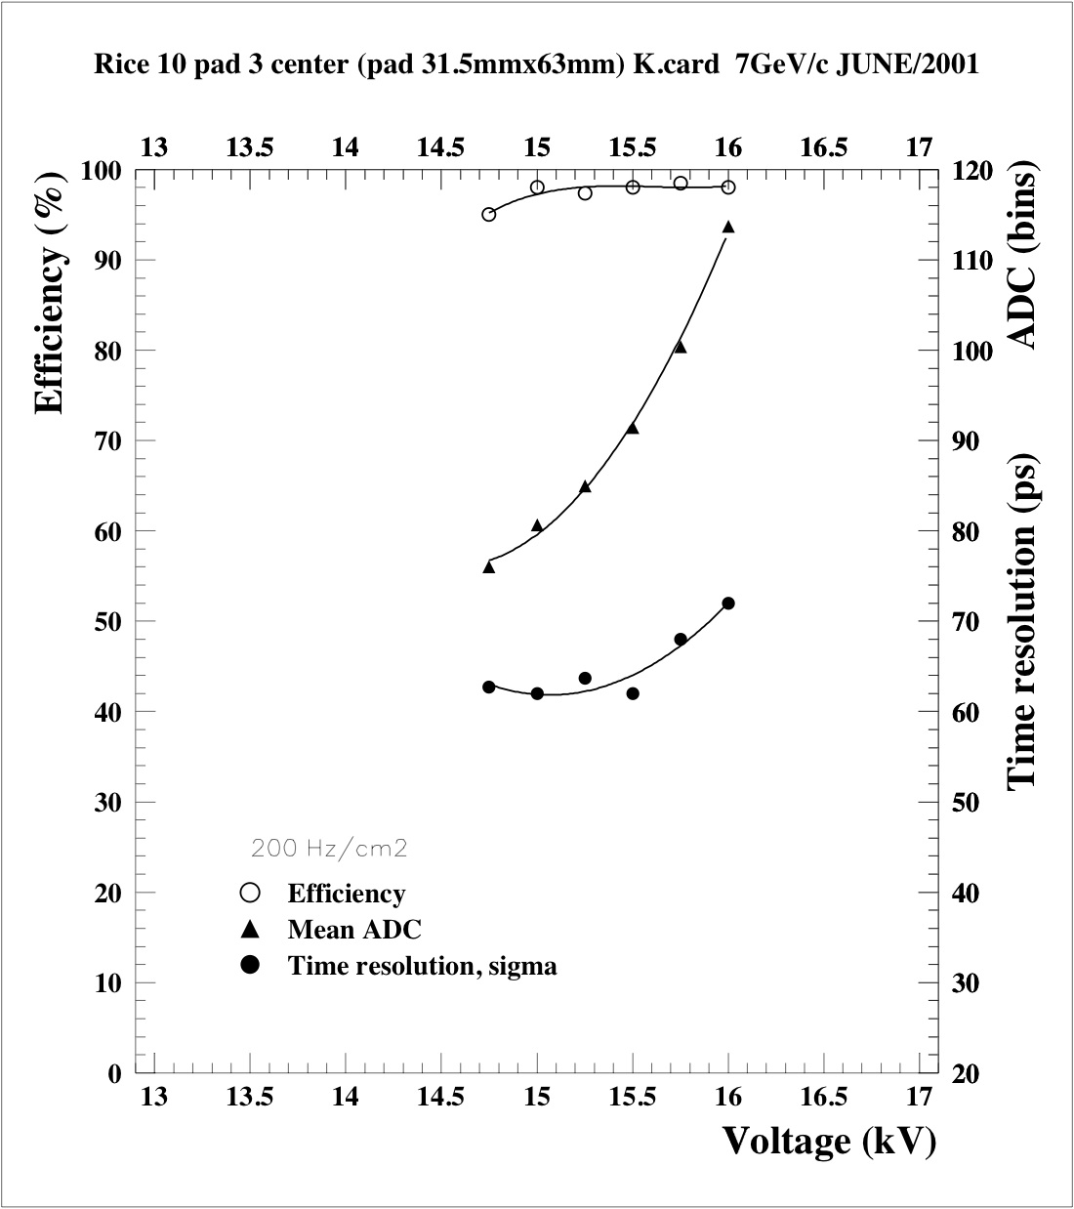
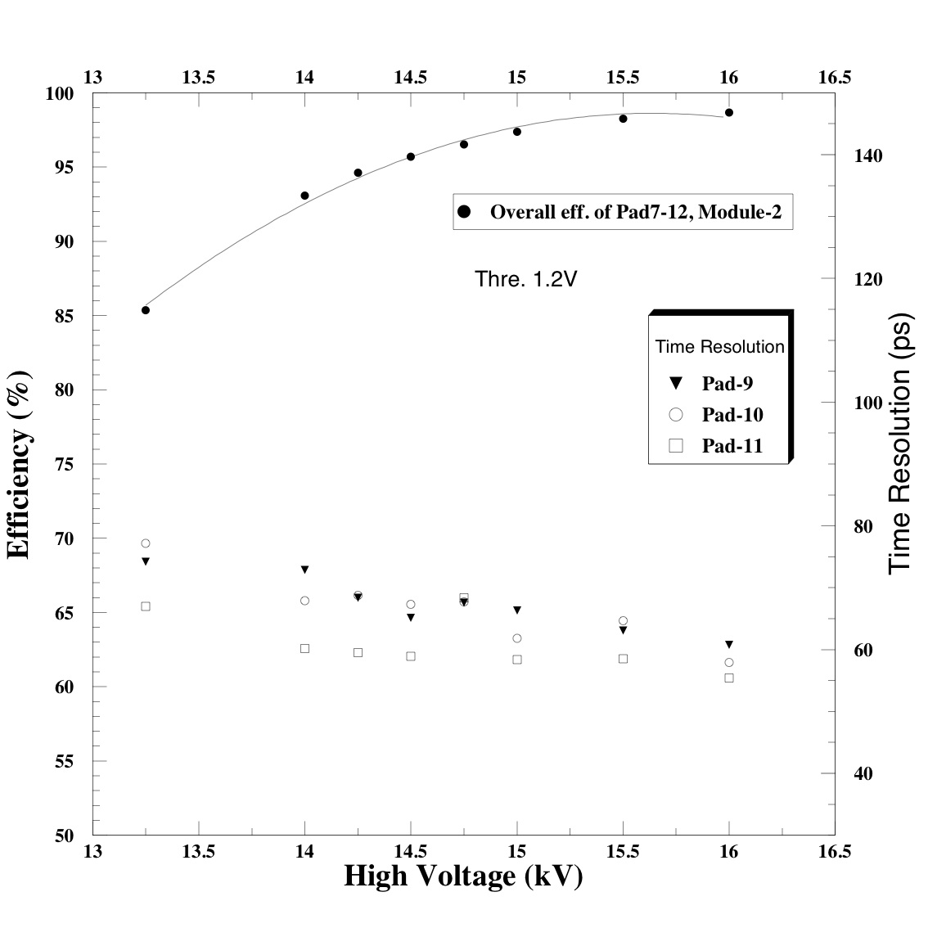
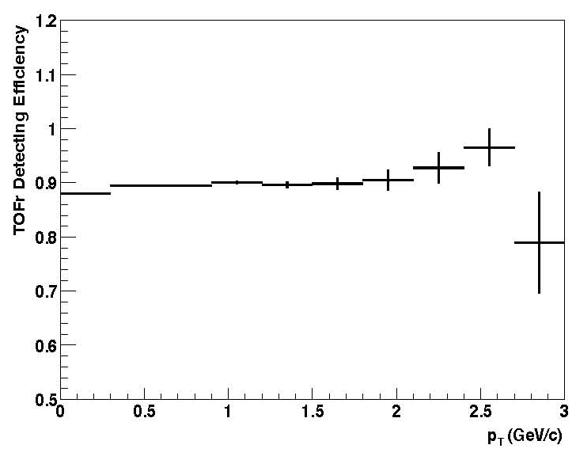
TOF Efficiency
Efficiencies in Test Beams and STAR
2001 CERN test beam
2003 AGS test beam
STAR Run 3 (TOFr)
Lijuan Ruan

Slide 22
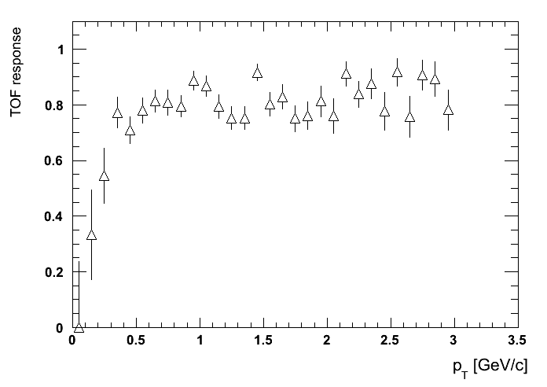
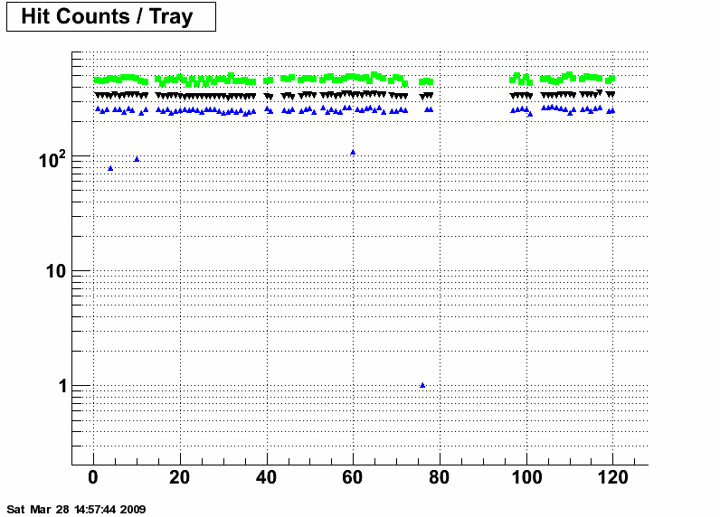
TOF Efficiency (cont’d)
STAR Run 8 (TOFr)
Run 8
  significant pile-up complicates analysis
    ~12% remaining pile-up
Run 9
  pile-up issue diffucult to handle in Fast-offline data
  detailed analysis pending STAR production, incl. EMC and final TPC calibration (~Sept’09)
  from test beam data we know that good time resolutions mean high efficiencies
  observed hit patterns in Run9 are constant
Fu Jin
Run 10087063
Run 9
max, average, min

Slide 23
Summary
TOF stable operations during Run 9
  very useful to verify calibration/production procedures
TOF calibration: full-steam ahead
    TOF calibration depends on TPC calibration
  500GeV: preliminary calibration, ready for STAR database
  200GeV: first preliminary calibration, verification in progress
  will require a larger data sample
    verify the effect of the different discriminator threshold settings, verify field polarity change, verify effect of final TPC calibration
Preliminary p+p results for TOF resolution agree with TOF Project requirement (100±15ps for Au+Au)
  expect further improvements by increasing statistics
  expect a significant improvement of start-side resolution in full energy Au+Au (see Llope’s presentation) ranging from 44ps in very peripheral down to 23ps in mid-central to central collisions.
  Expect associated overall TOF time resolutions between 88-96ps.

